Slide 1

HealthCare Data Analysis
Bang Gong, Hanzhe Guo, and Zhijie Duan
University of North Carolina at Chapel Hill

Slide 2
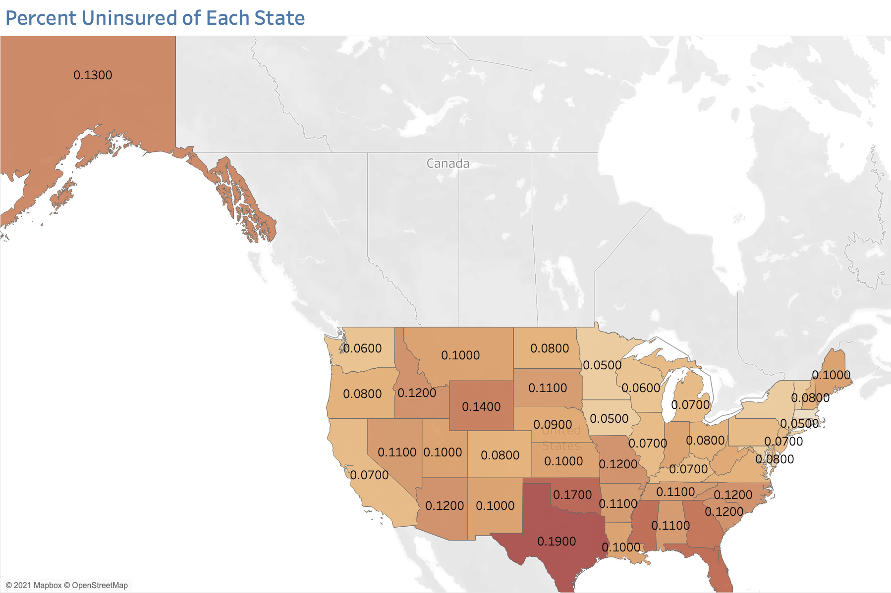

Slide 3
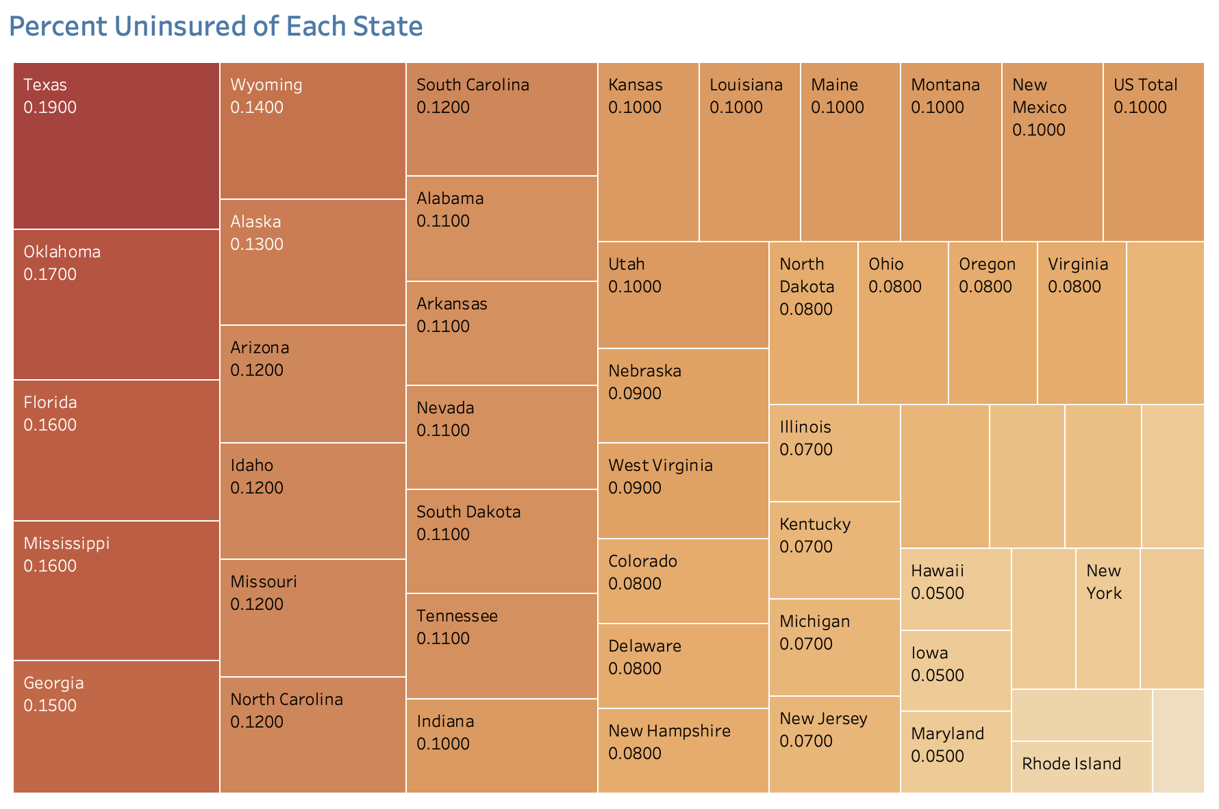

Slide 4
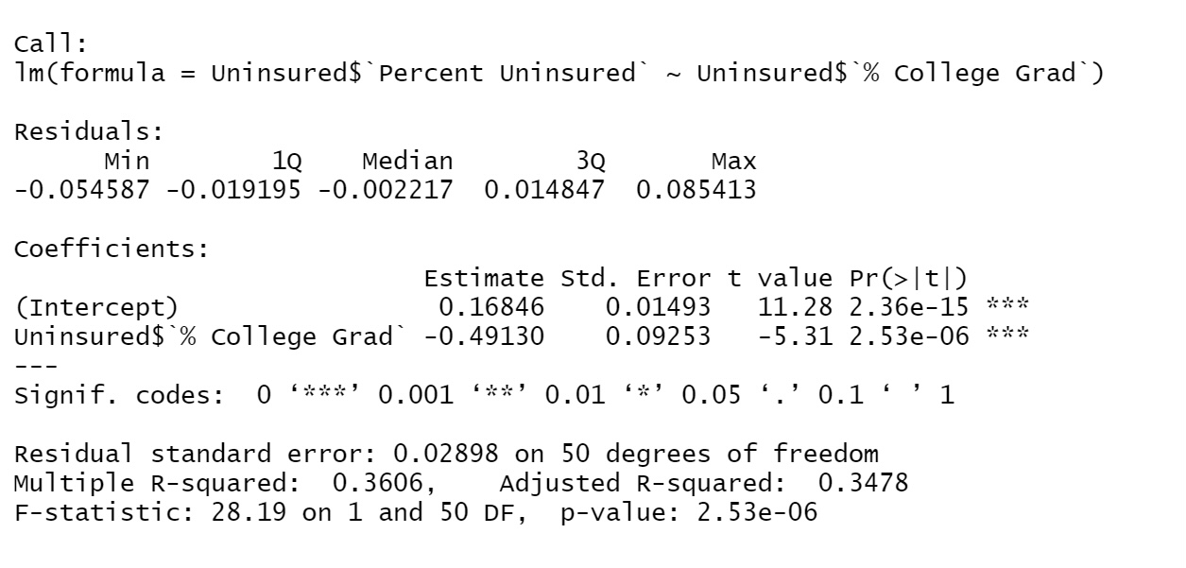
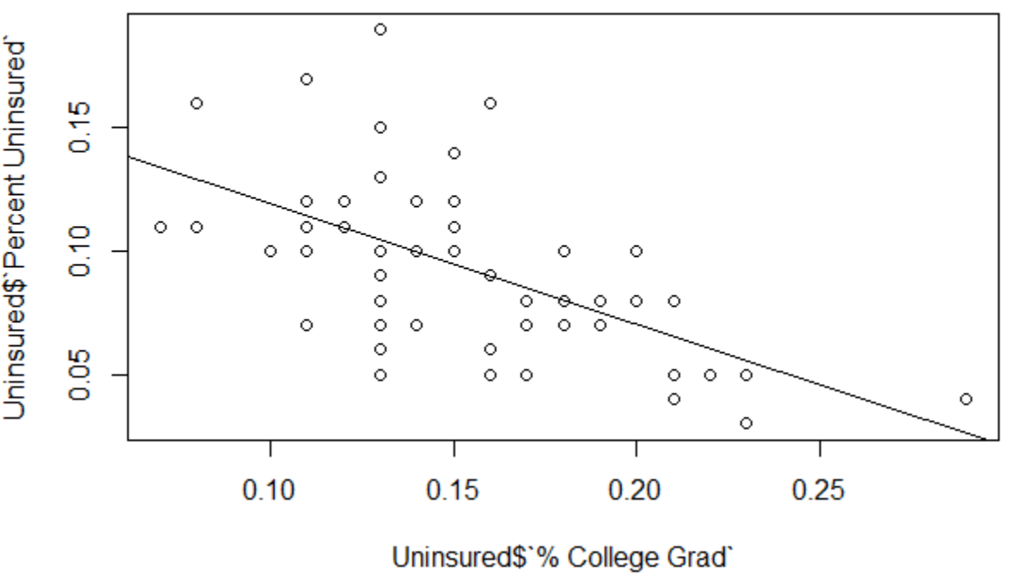
Correlation between college grad percentage and uninsured percentage
Our hypothesis is that a state with a higher percentage of college grad will have a lower percentage of uninsured population.
We build a linear regression model to test the correlation.
The multiple R-squared is about 0.36, which means about 36% of the variation in the uninsured percentage can be explained by the change in the college grad percentage.
The slope is -0.491, which means there is a negative correlation. P-value for the slope is 2.53e-06 (less than 0.05), which means the slope is significant and not due to chance.

Slide 5
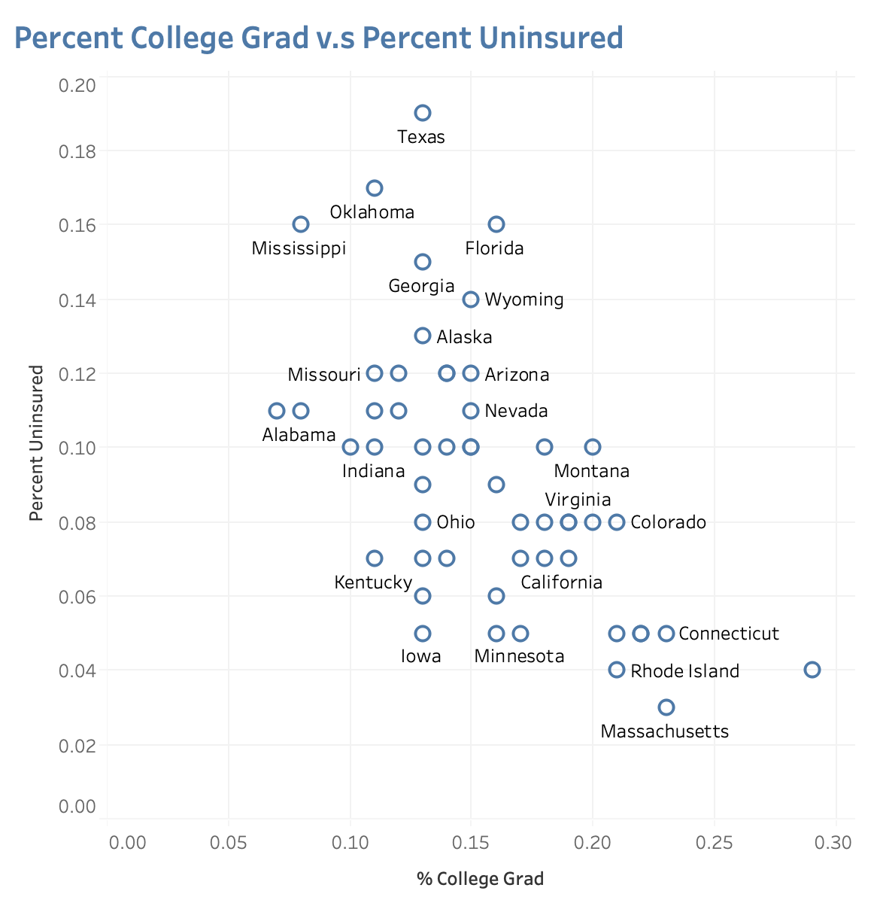

There is a negative correlation between college grad percentage and uninsured percentage.
Possible Explanation:
People with higher education level tend to have a better understanding of the necessity of health insurance.

Slide 6
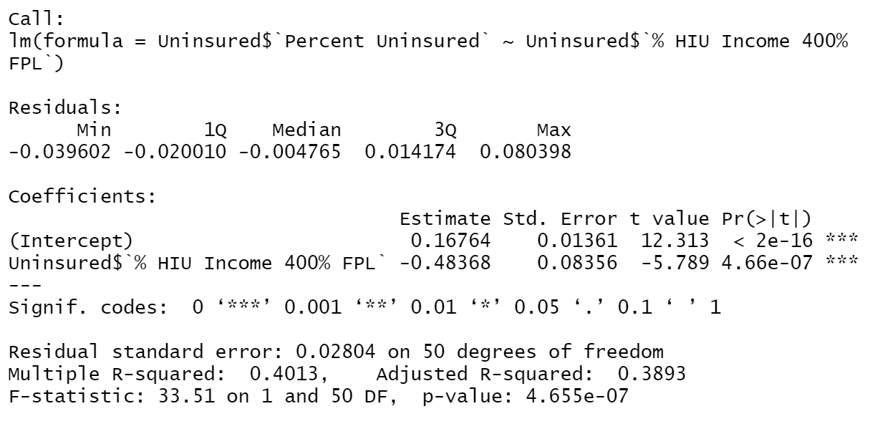
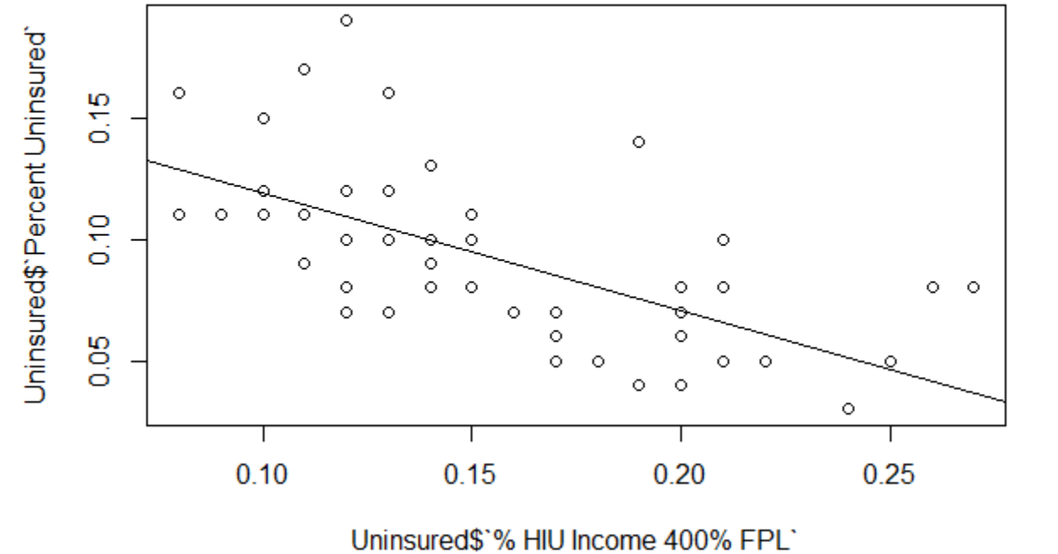
Correlation between Health Insurance Unit(HIU) 400% FPL income percentage and uninsured percentage
Our hypothesis is that a state with a higher percentage of HIU 400% FPL income will have a lower percentage of uninsured population.
We build a linear regression model to test the correlation.
The multiple R-squared is about 0.401, which means about 40.1% of the variation in the uninsured percentage can be explained by the change in the percentage of HIU 400% FPL.
The slope is about -0.48, which means there is a negative correlation. P-value for the slope is 4.66e-07 (less than 0.05), which means the slope is significant and not due to chance.

Slide 7
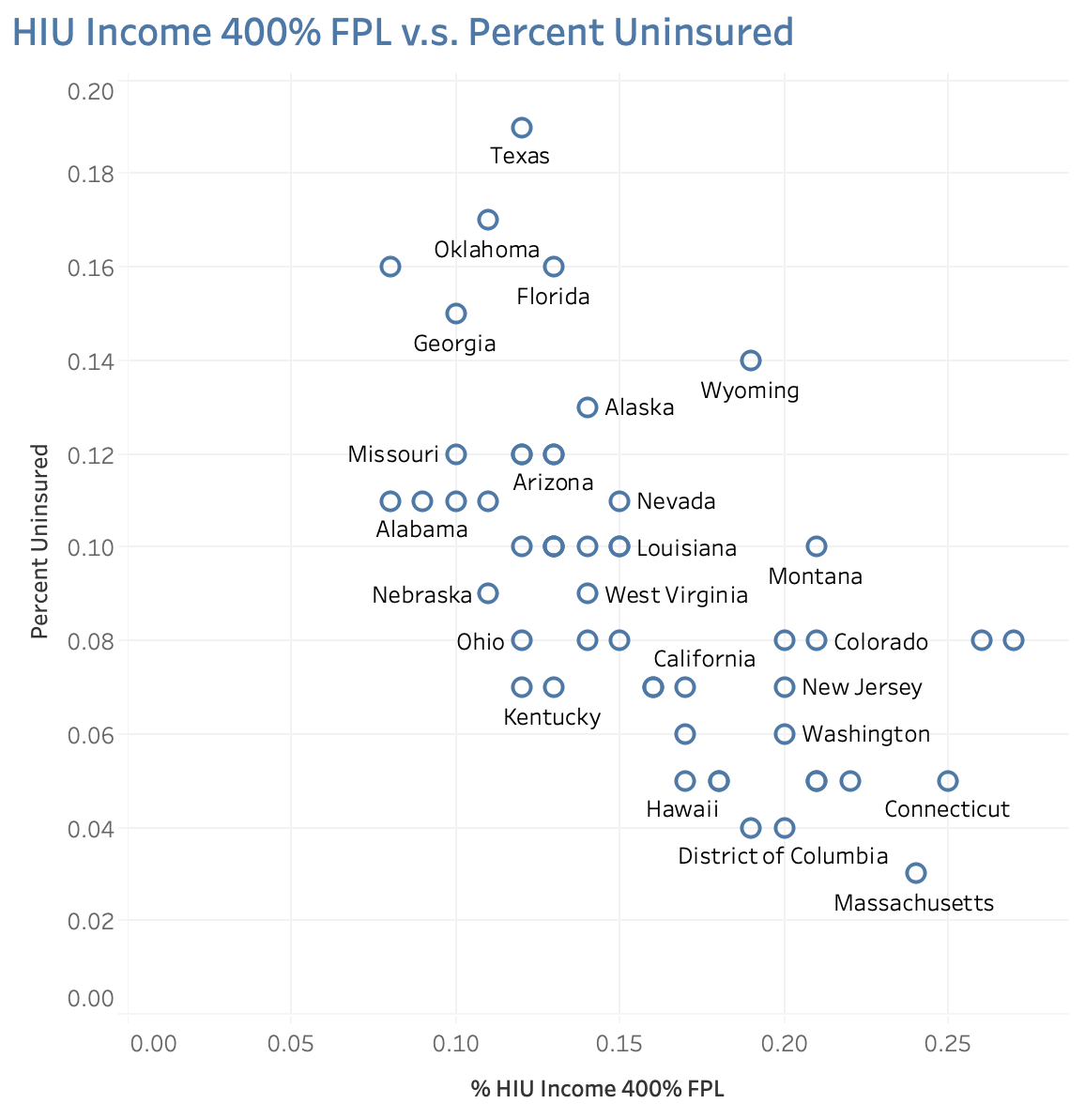
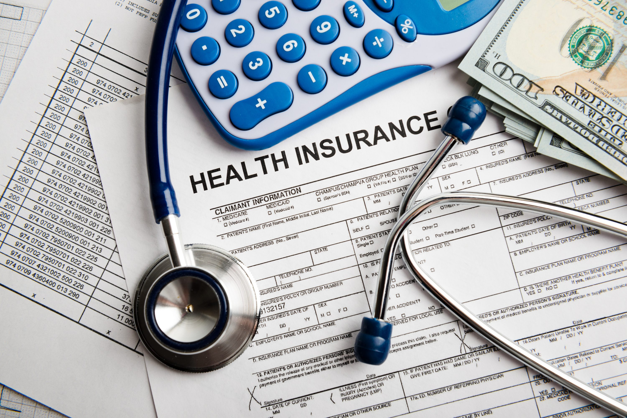
There is a negative correlation between Health Insurance Unit(HIU) 400% FPL income percentage and uninsured percentage.
Possible Explanation:
People with higher family incomes tend to afford health insurance better.

Slide 8
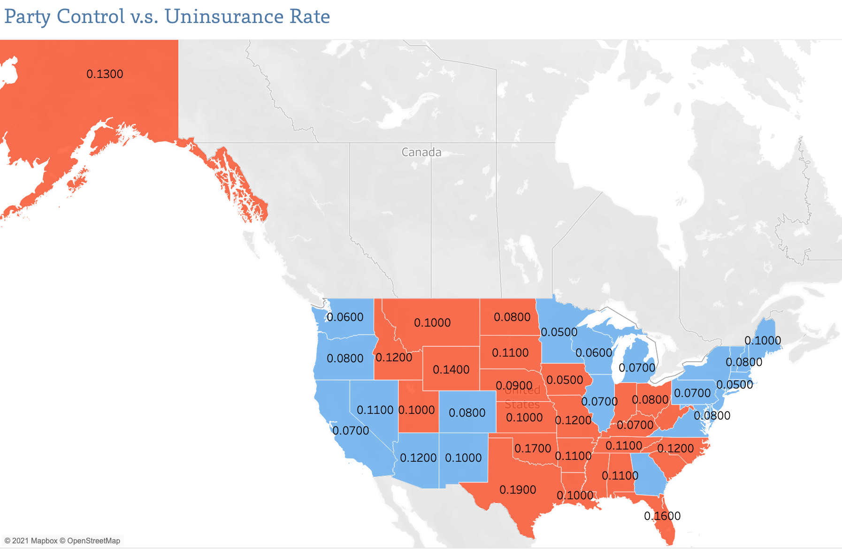

Slide 9
Thank you

